Slide 1



Fuzzy logic trained systems and Color Science applications
Samuel Morillas

Slide 2
Fuzzy logic
Arises from the need to represent non binary certainties of facts
Fuzzy logic considers that an statement can have any degree of certainty in [0,1]
First concept defined where the fuzzy sets that allow partial membership

Slide 3
Fuzzy logic systems
Contain a series a implication IF-THEN rules
Are motivated from the desired to emulate human described solutions for problems using anbiguous implication rules.

Slide 4
Fuzzy logic system: example
Imagine we have an AC controler. D is the difference between target tempertature and actual temperatue. A rule may be:
IF D is HIGH then AC power is HIGH
Fuzzy logic has an algebra that allows to compute the degree of certainty of the statement ‘D is high’, then infer the certainty for ‘AC power is HIGH’ and finally compute the actual power the AC controller needs to use
This kind of systems are called Mamdani and are the most easy to interprete but have some performance limitation

Slide 5
Fuzzy logic system: example
The alternative to Mamdani systems are the Takagi ones that difer in the consequent of the rule. Here, the rule could be:
IF D is HIGH then p=f(D)
Here the power, p, is directly computed by the function defined in the consequent from D. Different rules would have different antecedents and different consequent functions. These systems allow for multiple rules to be activated simulatneosly and in that case output is computed from combining all of them with proper activation weights.
These systems are better for function approximation

Slide 6
Trained fuzzy logic systems
While Fuzzy systems have beed developed in the past using human expert knowledge, nowadays we have situations where we do not have knowledge to relate variables but we have plenty of data
Some procedures are being developed to create fuzzy systems from data
The advantage of these systems is their interpretability with respect to black box approaches as neural networks and other machine learning models

Slide 7
Trained fuzzy logic systems: FMID model
How does it work?
1. A predefined number of rules must be set along with a degree of uncertainty for the system
2. The model clusterizes the data into as many clusters as rules
3. It uses fuzzy clustering with overlapping proportional to the uncertainty to be modelled
4. For each cluster, fits a consequent function by squared error minimization
5. The cluster membership function and the consequent function form a Takagi type fuzzy rule

Slide 8
Trained fuzzy logic systems: FMID model
How many rules?
The more, the more overfitting likelihood
The more, more difficult to interprete
Minimum number of rules that makes the system is not overfitted and is easy to interprete

Slide 9
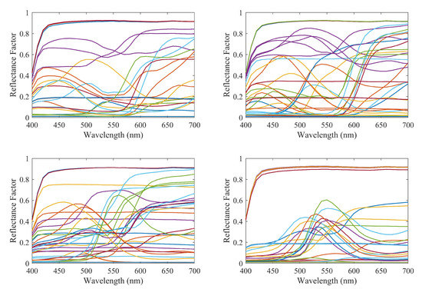
Application: spectral curve recovery
Maali Amiri M, Garcia-Nieto S, Morillas S, Fairchild MD. Spectral Reflectance Reconstruction Using Fuzzy Logic System Training: Color Science Application. Sensors. 2020; 20(17):4726.
RGB/XYZ vs spectral curve data

Slide 10
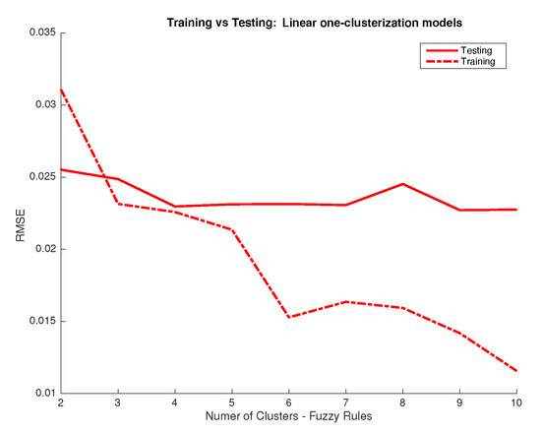
Application: spectral curve recovery
Studying the number of rules

Slide 11
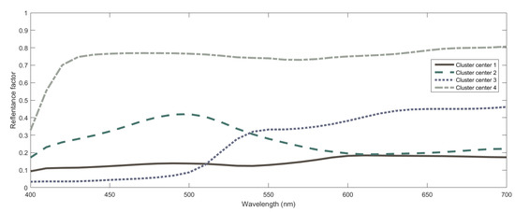
Application: spectral curve recovery
What did the system learned?
Mixing 4 spectral curves was the best solution to recover the rest

Slide 12
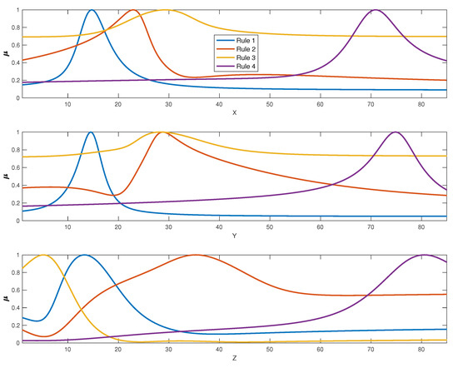
Application: spectral curve recovery
What did the system learned?
Looking at the cluster membership functions we can understand them

Slide 13
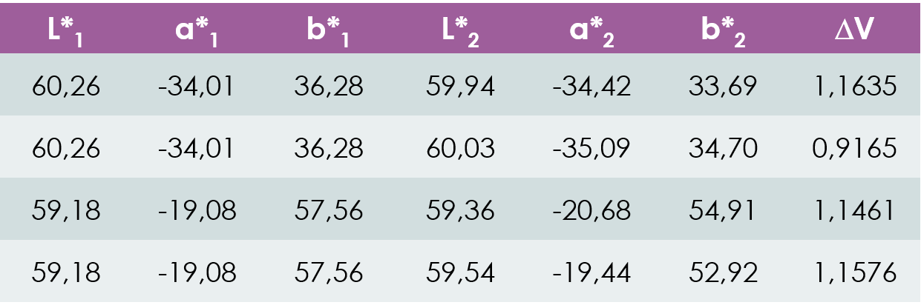
Application: color difference computation
S. Morillas, R. Huertas, P. Latorre, J.J. Miñana, ‘Fuzzy logic system for computing color differences’, National color conference 2025. Mérida, Spain.
L*a*b*-L*a*b* vs DV data
Inputs: Average L*a*b* and squared differences
Output: squared visual difference

Slide 14
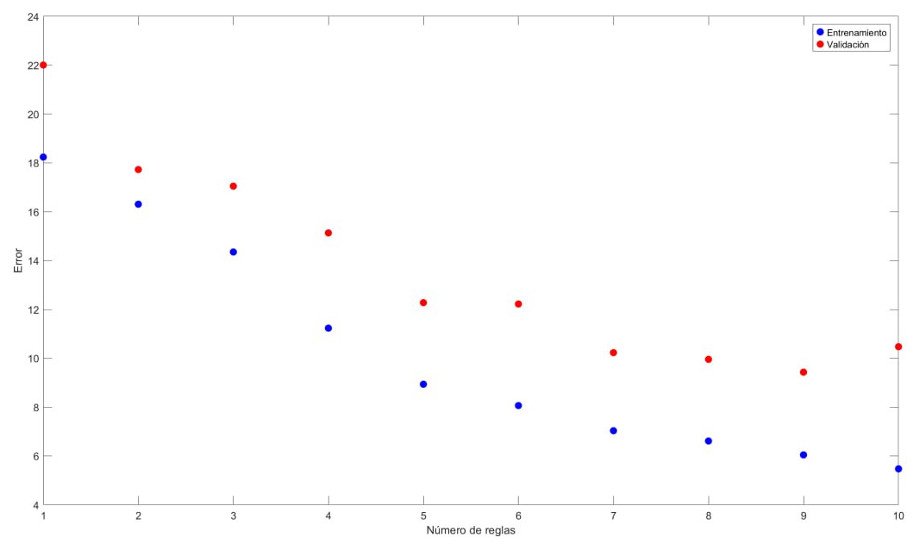
Application: color difference computation
What did the system learned?
5 rules is the best choice

Slide 15
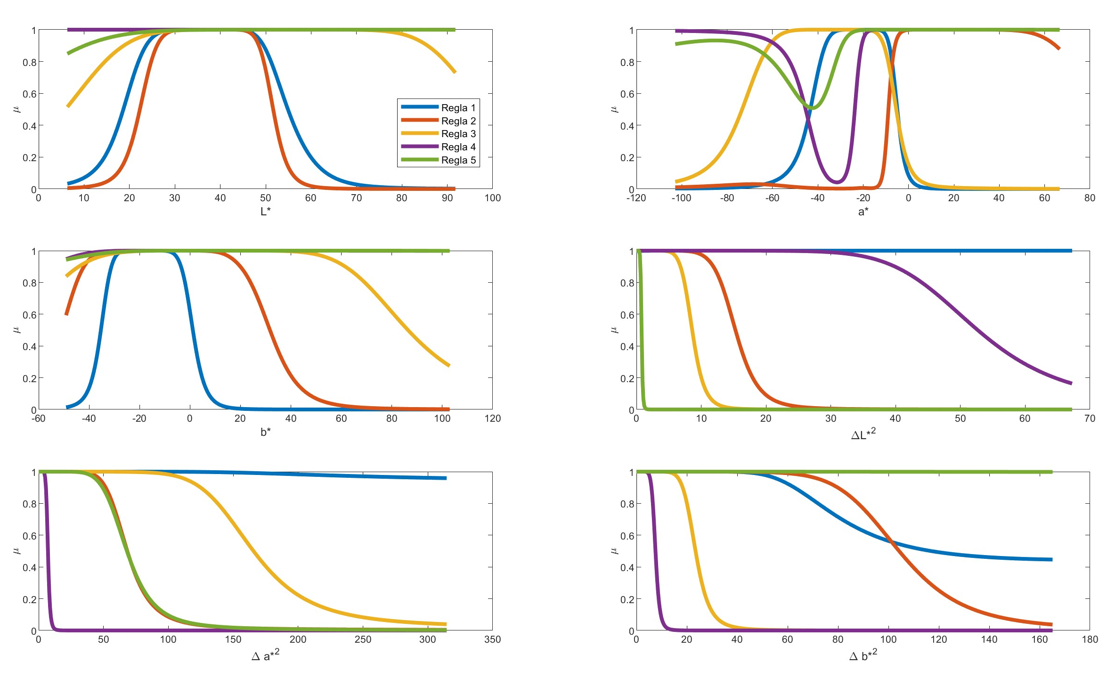
Application: color difference computation
Interpreting the rules
Color space region matters
Magnitude difference matters
It’s a nonlinear problem!!

Slide 16
Application: color difference computation
Consequent functions can be seen as well
Rule 1: 0.14L*-0.35a*+1.3b*+0.07ΔL*²+0.09Δa*²+0.29Δb*²+34
Rule 2: 0.21L*+0.01a*-0.01b*+0.60ΔL*²+0.06Δa*²+0.05Δb*²–7.1
Rule 3: -0.01L*+0.14a*+0.00b*+0.26ΔL*²+0.06Δa*²+0.20Δb*²+9.1
Rule 4: -0.02L*-0.01a*-0.00b*+0.37ΔL*²+0.48Δa*²+0.03Δb*²+1.8
Rule 5: 0.03L*-0.03a*-0.00b*+5.8ΔL*²+0.33Δa*²+0.08Δb*²+1.4

Slide 17
Application: display characterization
Khleef Almutairi, Samuel Morillas, Pedro Latorre-Carmona, Makan Dansoko, María José Gacto, A comparative analysis of machine learning methods for display characterization, Displays,Volume 85,2024,102849.
RGB vs XYZ colorimetric data
We developed models for LCD, OLED and QLED displays

Slide 18
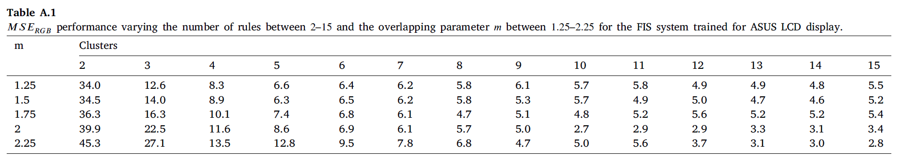
Application: display characterization
Number of rules and system uncertainty

Slide 19
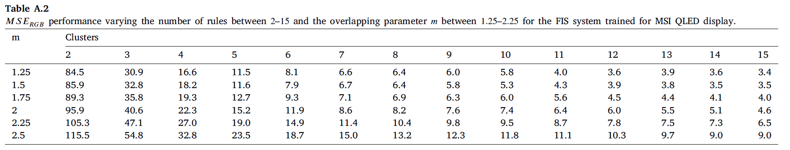
Application: display characterization
Number of rules and system uncertainty

Slide 20
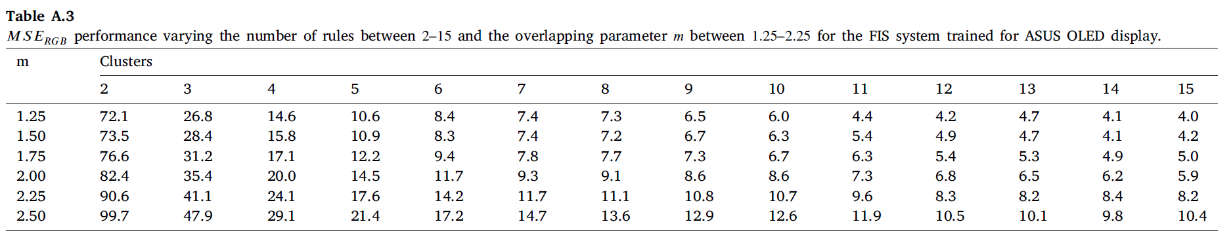
Application: display characterization
Number of rules and system uncertainty
OLED and QLED need more rules

Slide 21
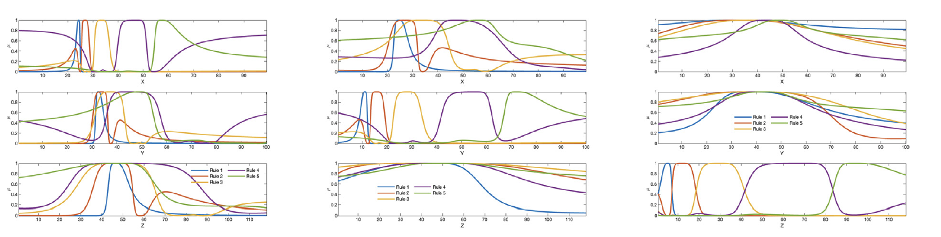
Application: display characterization
LCD model
6 regions of color space

Slide 22
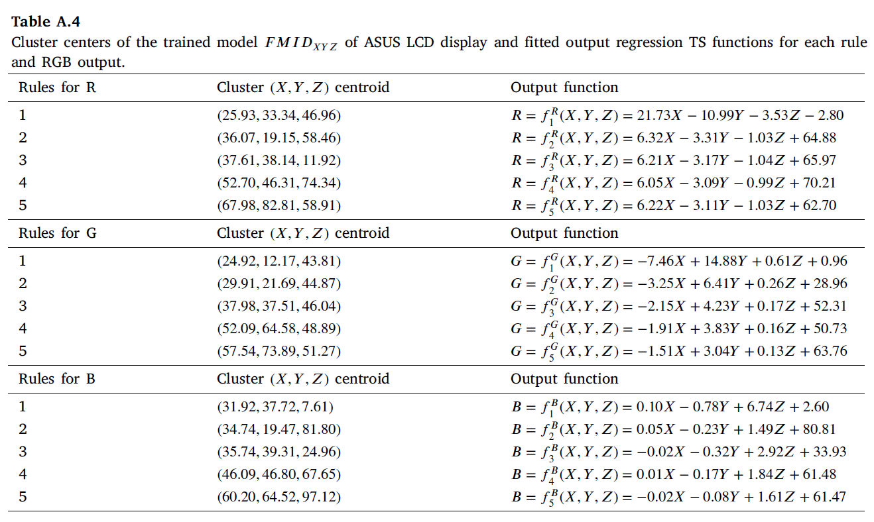
Application: display characterization
Consequent functions show how to compensate for R, G and B not only generating X, Y and Z stimulus

Slide 23
FMID limitations and future challenges
Membership functions have sometimes shapes difficult to interprete
Consequent function fitting is done independently for each rule but many times will be activated simultanously
Research on other systems that generate simpler membership functions
Develop more complex optimization strategies

Slide 24
Thank you!
Samuel Morillas

