Slide 1

Color Rendering Indexes for Color Blind Observers
Rafael Huertas
Department of Optics, Faculty of Science, University of Granada, Spain.

Slide 2

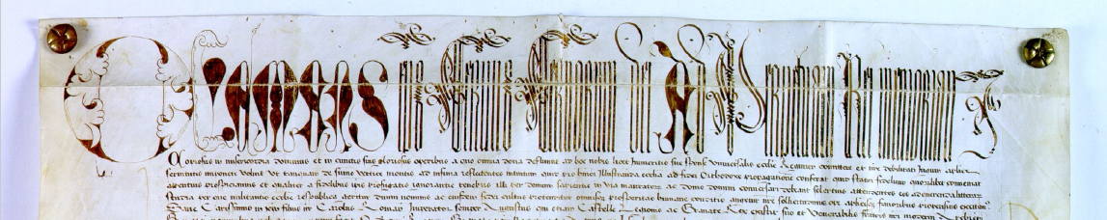
University of Granada
University of Granada (UGR)
Founded in 1531
It roots can be traced back to the Madrasahs of the last Nasrid Kingdom

Slide 3
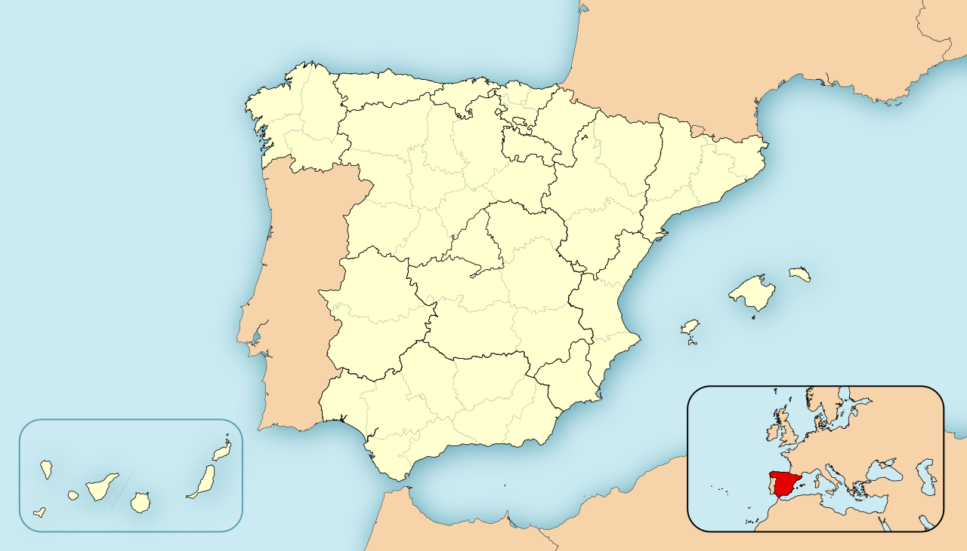

7 Campuses distributed in 3 cities: Granada, Ceuta and Melilla
Granada
Spain
Ceuta
Melilla

Slide 4
The UGR in figures (https://serinnova.ugr.es/odip/ugr_en_cifras/):
Centers:
26 owned centers + 1 associated center
124 Departments
19 Research Centers
Education offered:
98 Bachelor’s Degrees
157 Master’s Degrees
28 PhD Programs
University Community:
Students: 56.842
Bachelor’s Degrees: 46.281
Master’s Degrees: 6.859
PhD students: 3.702
Teaching and research staff: 3.682
Administration and services staff: 2.576

Slide 5
University of Granada
Academic Ranking of World Universities (ARWU) (Shanghai Ranking):
Position: 201-300.
2nd Best Spanish University
National Top 5 in scientific publications (SCIE/SSCI)
https://www.shanghairanking.com/institution/university-of-granada
https://canal.ugr.es/noticia/la-ugr-se-situa-como-la-segunda-mejor-universidad-de-espana-segun-la-nueva-edicion-del-ranking-de-shangai/

Slide 6
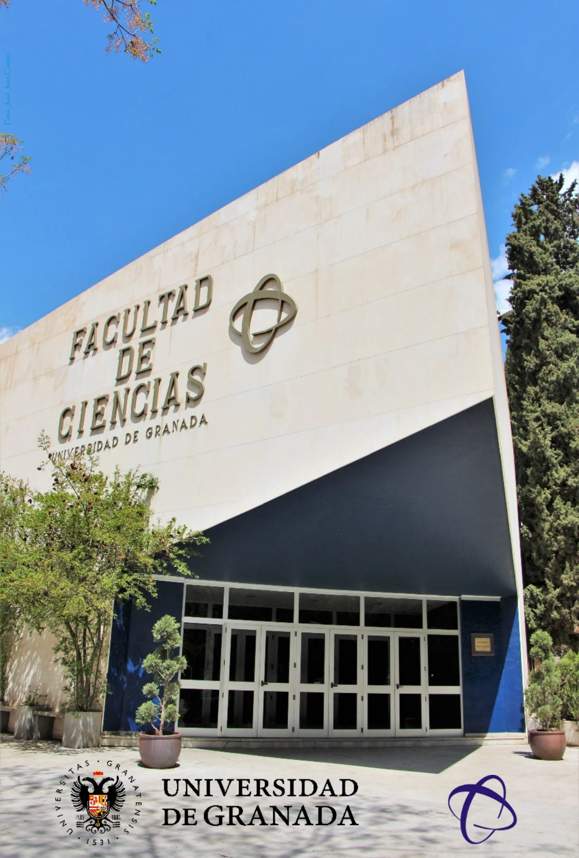

Faculty of Science
(one over 26 centers in the UGR)
Education offered:
14 Bachelor’s Degrees
23 Master’s Degrees
7 Doctoral Programs
University Community:
More than 5.000 students
Teaching and research staff: 838
Administration and services staff: 123

Slide 7
Faculty of Science
29 Departments:
Algebra, Análisis Matemático, Biología Celular, Bioquímica y Biología Molecular, Botánica, Ecología, Edafología y Química Agrícola, Electromagnetismo y Física de la Materia, Electrónica y Tecnología de Computadores, Estadística e Investigación Operativa, Estratigrafía y Paleontología, Física Aplicada, Física Atómica Nuclear y Molecular, Física Teórica y del Cosmos, Fisiología Vegetal, Genética, Geodinámica, Geometría y Topología, Ingeniería Química, Matemática Aplicada, Microbiología, Mineralogía y Petrología, Óptica, Parasitología, Química Analítica, Química Física, Química Inorgánica, Química Orgánica, Zoología

Slide 8

Department of Optics
https://www.ugr.es/universidad/organizacion/entidades/departamento-optica
https://optica.ugr.es/
Staff
Teaching and research staff: 44
Administration and services staff: 2

Slide 9
Department of Optics
Department of Optics. Teaching
4 Bachelor’s Degrees
Óptica y Optometría
Física
Ingeniería de Tecnologías de Telecomunicación
Ingeniería Química
5 Master’s Degrees
Máster Erasmus Mundus COSI – Computational Colour and Spectral Imaging.
Máster en Física: Radiaciones, Nanotecnología, Partículas y Astrofísica.
Máster en Ingeniería Acústica.
Máster en Investigación en Optometría y Óptica Visual.
Ingeniería Química
PhD Program in Physics and Space Sciences

Slide 10
Department of Optics
Research groups and labs:
FQM-151 Grupo de Óptica de Granada
Color Imaging Laboratory
Laboratory of Biomaterials Optics
Laboratory of Vision Sciences and Applications
Basic and Applied Colorimetry Laboratory
Clinical and Laboratory Applications of Research in Optometry
Texture and Color in Imaging

Slide 11
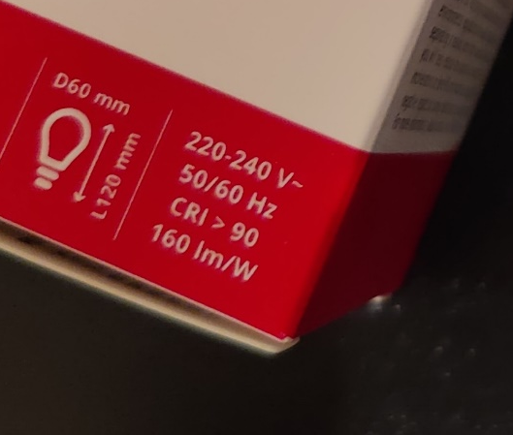

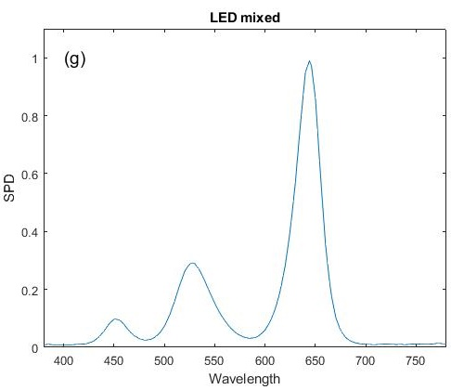
Introduction: Color Rendering Index
Light sources’ characterization parameters: electric power, luminous efficiency, correlated color temperature, and Color Rendering Index (CRI).
Included in the commercial lamp’s specifications.
LED lamps offer, besides of excellent efficiency, great versatility in the design of the spectral power distribution (SPD).

Slide 12
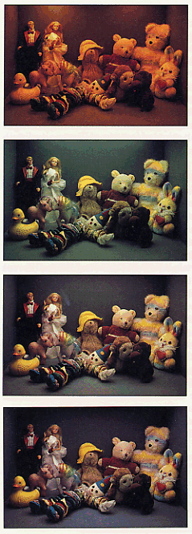
Introduction: Color Rendering Index
Quantitative measure of the ability of a light source to reveal the colors of objects faithfully in comparison with a natural or standard light source.
Low CRI can make objects appear to have unnatural or dull colors.
Essential in applications where accurate color reproduction is important: photography, retail and commercial spaces, museums, art restoration, healthcare facilities (i.e., neonatal care).
F8 (CCT=5000 K); R_{a}=90
F2 (CCT=3500 K); R_{a}=64

Slide 13

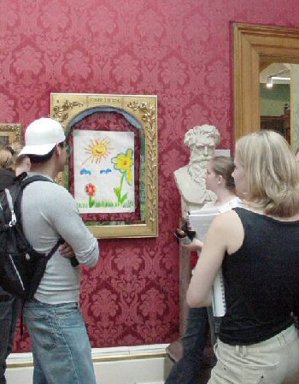
Introduction: Color Vision Deficiency
In color perception not only the object and light source are involved but also the observer.
Prevalence of color vision deficiencies (CVD) is not negligible but quite important: 8% of males.
The most common type is red-green CVD (protan and deutan type).
CVD would have a significant impact on a person's life making difficult to perform some tasks: reading color maps, choosing ripe fruit, distinguish the color of certain indicative lights (LEDs), etc.
For CVD people, the capacity of the lamps to reproduce colors will be different, depending on the type and severity of the deficiency.

Slide 14
Objetive
To propose a method to compute color rendering of lamps for CVD people.
Normal color vision
Color rendering index
Type
Color Vision Deficiency
Severity

Slide 15
Method: lamps
Introduction
Dataset ANSI/IES TM-30-20 (318 Spectral Power Distributions)
Illuminants (20 SPD)
Equal energy illuminant.
7 CIE daylight illuminants: D50, D55, D60, D65, D70, D75, and D80.
12 CIE fluorescent illuminants: F1 to F12.

Slide 16
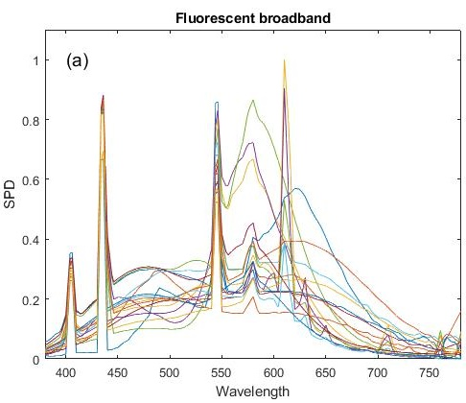
Method: lamps
Introduction
Dataset ANSI/IES TM-30-20 (125 Spectral Power Distributions)
Illuminants (20 SPD)
Equal energy illuminant.
7 CIE daylight illuminants: D50, D55, D60, D65, D70, D75, and D80.
12 CIE fluorescent illuminants: F1 to F12.
Commercial lamps (105 SPD)
17 fluorescent broadband.

Slide 17
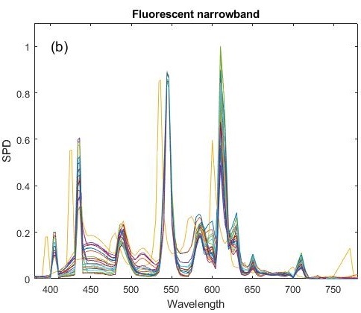
Method: lamps
Introduction
Dataset ANSI/IES TM-30-20 (125 Spectral Power Distributions)
Illuminants (20 SPD)
Equal energy illuminant.
7 CIE daylight illuminants: D50, D55, D60, D65, D70, D75, and D80.
12 CIE fluorescent illuminants: F1 to F12.
Commercial lamps (105 SPD)
17 fluorescent broadband.
22 fluorescent narrowband.

Slide 18
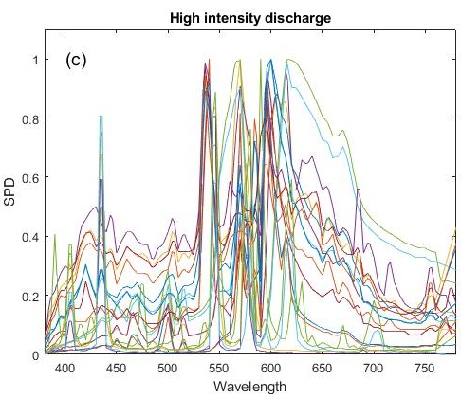
Method: lamps
Introduction
Dataset ANSI/IES TM-30-20 (125 Spectral Power Distributions)
Illuminants (20 SPD)
Equal energy illuminant.
7 CIE daylight illuminants: D50, D55, D60, D65, D70, D75, and D80.
12 CIE fluorescent illuminants: F1 to F12.
Commercial lamps (105 SPD)
17 fluorescent broadband.
22 fluorescent narrowband.
20 high intensity discharge.
Notes:
20 high intensity discharge.

Slide 19
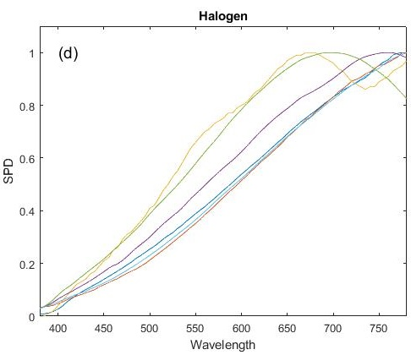
Method: lamps
Introduction
Dataset ANSI/IES TM-30-20 (125 Spectral Power Distributions)
Illuminants (20 SPD)
Equal energy illuminant.
7 CIE daylight illuminants: D50, D55, D60, D65, D70, D75, and D80.
12 CIE fluorescent illuminants: F1 to F12.
Commercial lamps (105 SPD)
17 fluorescent broadband.
22 fluorescent narrowband.
20 high intensity discharge.
6 halogen.
Notes:
6 halogen.

Slide 20
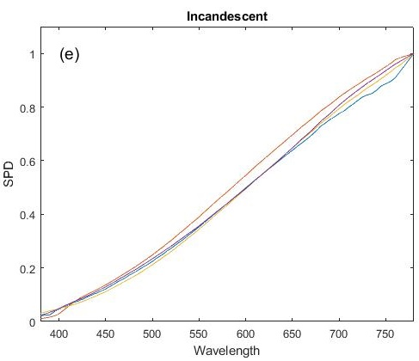
Method: lamps
Introduction
Dataset ANSI/IES TM-30-20 (125 Spectral Power Distributions)
Illuminants (20 SPD)
Equal energy illuminant.
7 CIE daylight illuminants: D50, D55, D60, D65, D70, D75, and D80.
12 CIE fluorescent illuminants: F1 to F12.
Commercial lamps (105 SPD)
17 fluorescent broadband.
22 fluorescent narrowband.
20 high intensity discharge.
6 halogen.
4 incandescent.

Slide 21
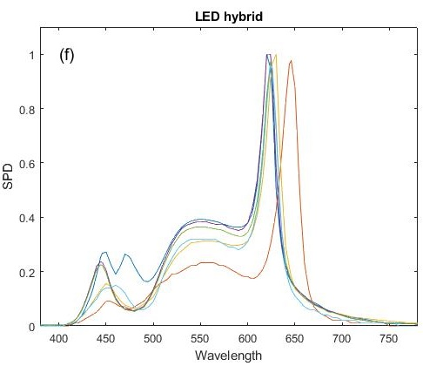
Method: lamps
Introduction
Dataset ANSI/IES TM-30-20 (125 Spectral Power Distributions)
Illuminants (20 SPD)
Equal energy illuminant.
7 CIE daylight illuminants: D50, D55, D60, D65, D70, D75, and D80.
12 CIE fluorescent illuminants: F1 to F12.
Commercial lamps (105 SPD)
17 fluorescent broadband.
22 fluorescent narrowband.
20 high intensity discharge.
6 halogen.
4 incandescent.
6 LED hybrid.

Slide 22
Method: lamps
Introduction
Dataset ANSI/IES TM-30-20 (125 Spectral Power Distributions)
Illuminants (20 SPD)
Equal energy illuminant.
7 CIE daylight illuminants: D50, D55, D60, D65, D70, D75, and D80.
12 CIE fluorescent illuminants: F1 to F12.
Commercial lamps (105 SPD)
17 fluorescent broadband.
22 fluorescent narrowband.
20 high intensity discharge.
6 halogen.
4 incandescent.
6 LED hybrid.
1 LED mixed.

Slide 23
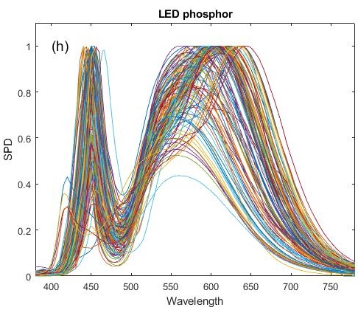
Method: lamps
Introduction
Dataset ANSI/IES TM-30-20 (125 Spectral Power Distributions)
Illuminants (20 SPD)
Equal energy illuminant.
7 CIE daylight illuminants: D50, D55, D60, D65, D70, D75, and D80.
12 CIE fluorescent illuminants: F1 to F12.
Commercial lamps (105 SPD)
17 fluorescent broadband.
22 fluorescent narrowband.
20 high intensity discharge.
6 halogen.
4 incandescent.
6 LED hybrid.
1 LED mixed.
29 LED phosphor.

Slide 24
Method: lamps
Introduction

Slide 25
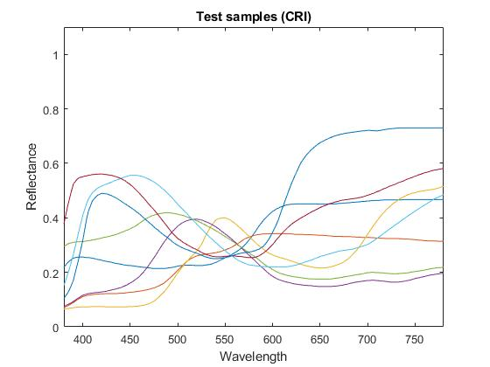

Method: Color Rendering Index R_{a}
Introduction
Recommended by the CIE.
A set of 8 samples (1 to 8).
Reference light source: CIE D65 illuminant.
Von Kries type chromatic adaptation.
Color difference in CIE 1964 U*W*V* Uniform Color Space:
Number | Munsell notation | Color name
1 | 7.5R 6/4 | Light grayish red
2 | 5Y 6/4 | Dark grayish yellow
3 | 5GY 6/8 | Deep yellow green
4 | 2.5G 6/6 | Yellowish green
5 | 10BG 6/4 | Light bluish green
6 | 5PB 6/8 | Light blue
7 | 2.5P 6/8 | Light violet
8 | 10P 6/8 | Light reddish purple
9 | 4.5R 4/13 | Deep red
10 | 5Y 8/10 | Deep yellow
11 | 4.5G 5/8 | Deep green
12 | 3PB 3/11 | Deep blue
13 | 5YR 8/4 | Caucasian skin
14 | 5GY 4/4 | Foliage green
15 | 1YR 6/4 | Japanese skin
$$ΔE_{i}={\left[{\left(U_{r,i}^{∗}−U_{k,i}^{∗}\right)}^{2}+{\left(V_{r,i}^{∗}−V_{k,i}^{∗}\right)}^{2}+{\left(W_{r,i}^{∗}−W_{k,i}^{∗}\right)}^{2}\right]}^{1/2}$$
Scaling (possible negative values):
$$R_{i}=100−4.6ΔE_{i}$$
Average of the R_{i} for the 8 samples.

Slide 26
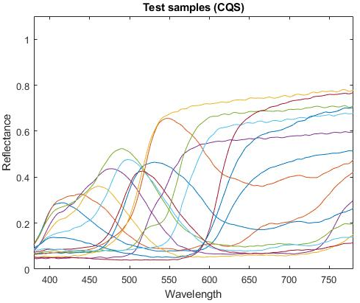
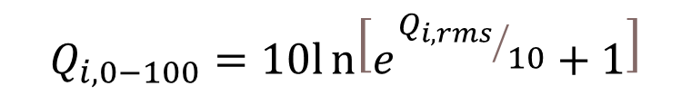
Method: Color Quality Scale Q_{a}
Introduction
Based on a psychophysical experiment: more comprehensive measure (NIST).
A set of 15 samples: including saturated and unsaturated colors.
Reference light source: CIE D65 illuminant.
CMCCAT2000 chromatic adaptation.
Color difference in CIELAB.
To avoid negative values, a 0-100 scale conversion is applied:
$$Q_{i,0−100}=10ln\left[e^{{Q_{i,rms}}/{10}}+1\right]$$

Slide 27
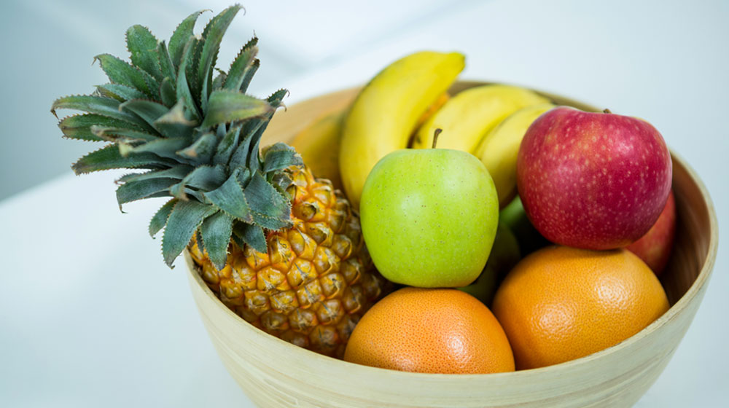
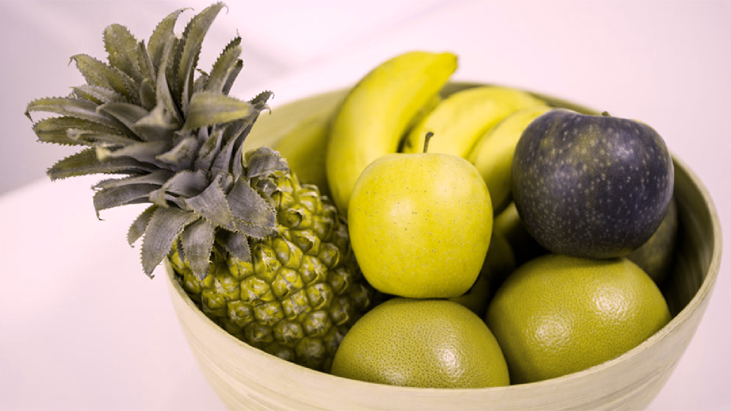
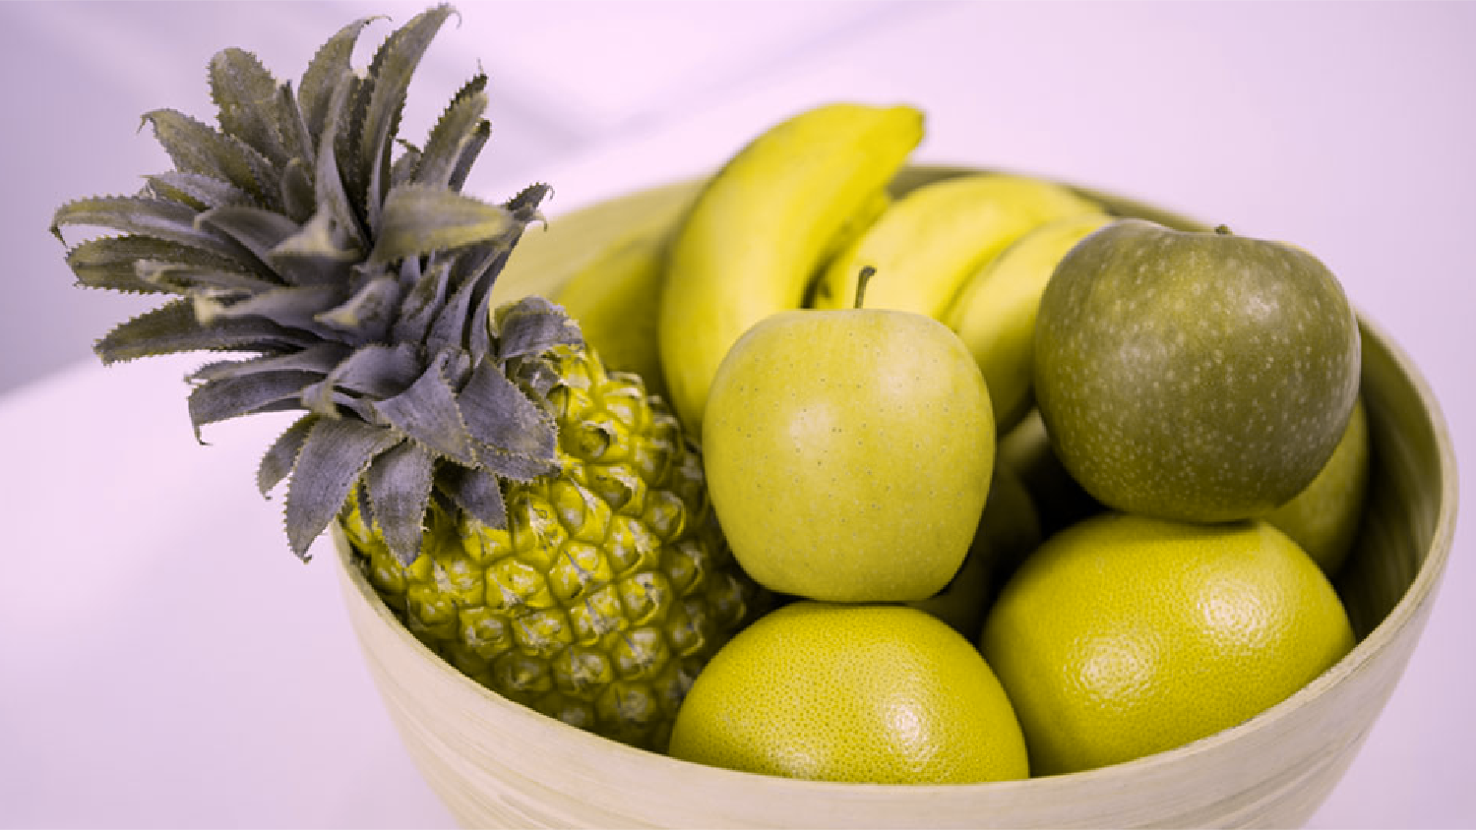
Method: CVD simulation
Introduction
Lucassen et al. model.
Varying amounts of weighting of L and M cone responses in the anomalous observers, modulated by a parameter called d (0 to 1 values).
For each type, protan and deutan, 6 conditions have been modeled with d varying from 0 to 1 in 0.2 steps.
The cases of d=0.3 and d=0.6 have been considered as mild and medium severity.
Normal color vision
Protanope (d=1)
Deuteranope (d=1)

Slide 28
Method: computations
Introduction
Reference Light source
Reference
Tristimulus values
Chromatic adaptation
Samples
Color difference
CRI
Tristimulus values
Test Light source
Test

Slide 29
Method: computations
Introduction
Reference Light source
CVD
Reference
Tristimulus values
Chromatic adaptation
Samples
Color difference
CRI
Tristimulus values
Test Light source
Test

Slide 30
Results: R_{a}
Introduction
Color vision | Normal | Protanomalous |  | Protanope | Deuteranomalous |  | Deuteranope
Severity |  | Mild | Medium |  | Mild | Medium
Equal energy | 88.51 | 90.87 | 93.19 | 94.82 | 91.98 | 93.06 | 92.12
CIE daylight illuminants | 94.37 (4.09) | 94.74 (3.76) | 95.11 (3.44) | 95.34 (3.20) | 95.00 (3.56) | 94.89 (3.60) | 94.17 (4.08)
CIE fluoresc. Illuminants | 71.22 (11.56) | 75.69 (10.54) | 79.31 (10.04) | 81.97 (9.90) | 75.08 (10.59) | 77.46 (10.74) | 78.55 (11.60)
Fluorescent broadband | 75.45 (12.80) | 79.43 (10.82) | 82.82 (9.48) | 85.18 (8.90) | 79.53 (11.15) | 81.47 (10.54) | 81.66 (10.66)
Fluorescent narrowband | 67.75 (12.15) | 72.03 (10.84) | 76.23 (9.19) | 80.12 (7.25) | 73.63 (9.02) | 75.79 (8.86) | 76.51 (10.18)
High intensity Discharge | 50.32 (19.42) | 57.11 (16.01) | 62.97 (14.06) | 67.23 (14.31) | 58.12 (16.92) | 61.15 (15.04) | 61.34 (14.40)
Halogen | 50.59 (4.38) | 55.94 (3.51) | 61.72 (2.58) | 66.94 (1.68) | 60.33 (2.55) | 60.58 (2.28) | 56.80 (2.56)
Incandescent | 48.04 (1.49) | 53.90 (1.34) | 60.20 (1.15) | 65.96 (0.97) | 58.81 (1.13) | 59.20 (1.14) | 55.21 (1.19)
LED hybrid | 48.30 (10.72) | 55.04 (8.42) | 62.36 (5.92) | 69.72 (3.12) | 60.19 (6.69) | 62.61 (5.14) | 60.21 (5.25)
LED mixed | -25.21 | 3.35 | 32.61 | 65.84 | 24.39 | 46.37 | 45.85
LED phosphor | 64.90 (9.73) | 68.44 (9.19) | 71.84 (8.37) | 74.88 (7.43) | 69.33 (7.50) | 70.50 (8.08) | 70.01 (10.05)

Slide 31
Results: simulation R_{a} samples
Introduction
Normal color vision. CIE D65 (reference)
Normal color vision. LED Mixed (R_{a}=-25.21)
Protanope. CIE D65 (reference)
Protanope. LED Mixed (R_{a}=65.84)

Slide 32
Results: Q_{a}
Introduction
Color vision | Normal | Protanomalous |  | Protanope | Deuteranomalous |  | Deuteranope
Severity |  | Mild | Medium |  | Mild | Medium
Equal energy | 96.23 | 96.36 | 96.79 | 98.38 | 95.61 | 95.54 | 96.73
CIE daylight illuminants | 97.52 (1.80) | 97.51 (1.79) | 97.68 (1.71) | 98.25 (1.52) | 97.30 (2.03) | 97.15 (2.12) | 97.53 (1.72)
CIE fluoresc. Illuminants | 74.99 (12.95) | 81.30 (9.28) | 86.08 (6.75) | 90.76 (5.52) | 79.83 (10.06) | 85.27 (6.66) | 90.62 (4.40)
Fluorescent broadband | 80.69 (13.20) | 85.12 (9.61) | 88.77 (6.90) | 93.08 (5.21) | 83.91 (9.94) | 87.38 (6.95) | 90.71 (5.38)
Fluorescent narrowband | 80.22 (3.83) | 85.10 (2.80) | 88.34 (2.55) | 91.40 (1.95) | 83.31 (3.91) | 87.39 (3.70) | 92.81 (3.03)
High intensity Discharge | 63.29 (25.71) | 71.15 (19.48) | 77.11 (14.59) | 83.21 (12.25) | 67.28 (19.96) | 73.40 (15.15) | 80.59 (14.05)
Halogen | 76.45 (1.14) | 77.06 (1.11) | 77.92 (1.03) | 81.04 (0.85) | 72.70 (1.50) | 72.15 (1.59) | 77.17 (1.26)
Incandescent | 75.82 (0.94) | 76.38 (0.87) | 77.30 (0.85) | 80.75 (0.80) | 71.77 (1.05) | 71.11 (1.02) | 76.34 (0.92)
LED hybrid | 79.76 (4.22) | 81.02 (4.73) | 82.47 (4.60) | 86.26 (3.89) | 77.81 (4.25) | 77.55 (5.03) | 81.29 (5.80)
LED mixed | 52.64 | 53.33 | 57.46 | 68.17 | 61.53 | 63.95 | 63.50
LED phosphor | 75.39 (3.94) | 80.85 (3.22) | 84.58 (3.40) | 88.24 (3.70) | 77.39 (4.01) | 81.74 (4.97) | 88.74 (4.77)

Slide 33
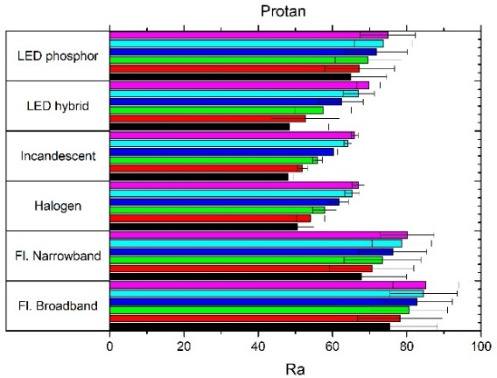
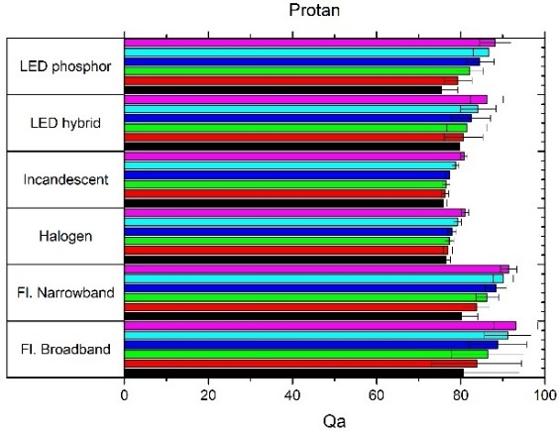
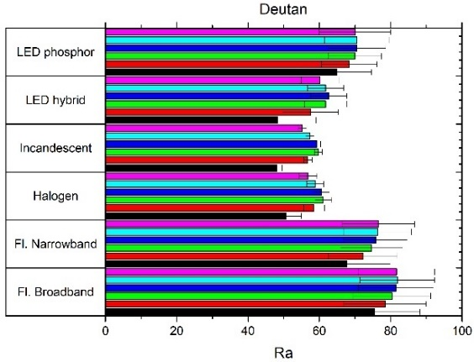
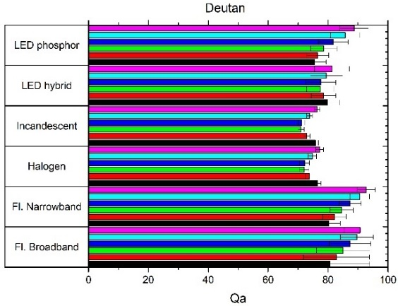
Results: degree of CVD
Introduction
R_{a}
Q_{a}

Slide 34
Conclusions
Introduction
For a lamp, the reproduction of colors depends on the type and severity of CVD.
In general, CVD increases the values of CRI (R_{a}) and CQS (Q_{a}).
Protanope people obtain the best color reproduction with almost any type of lamp.
Deutan type is different, specially considering the Q_{a}.
CQS moderates the differences between conditions in most of the cases.
CQS (Q_{a}) obtains better values than CRI (R_{a}), particularly for LED lamps.
Color rendering indexes must be developed and tested for CVD subjects.

Slide 35
Future work
Introduction
Use most sophisticated CVD simulations.
Use additional Color Rendering Index.
Test theoretical results with psychophysical experiments.
Desing SPD fitted for a type and severity of CVD.

Slide 36
References
Introduction
Commission Internationale de l'Eclairage, "Method of Measuring and Specifying Color Rendering Properties of Light Sources: Technical Report: CIE 13.3-1995“, (CIE, 1995).
W. Davis and Y. Ohno, "Color quality scale“, Optical engineering 49, 033602-16 (2010).
M. Neitz and J. Neitz, "Curing color blindness--mice and nonhuman primates“, Cold Spring Harb Perspect. Med. 4, a017418 (2014).
ANSI/IES TM-30-20, "Technical Memorandum: IES Method For Evaluating Light Source Color Rendition“, 74 (2019).
K. W. Houser, M. Wei, A. David, M. R. Krames, and X. S. Shen, "Review of measures for light-source color rendition and considerations for a two-measure system for characterizing color rendition“, Optics Express 21, 10393-10411 (2013).
M. P. Lucassen and J. W. Alferdinck, "Dynamic simulation of color blindness for studying color vision requirements in practice“, (2006).

Slide 37
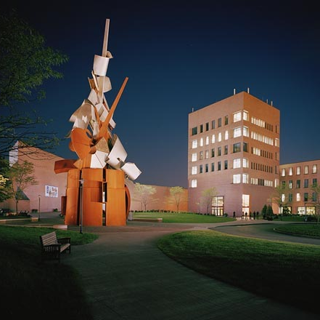
THANKS
rhuertas@ugr.es

