Slide 1



Ustress: Measuring Fidelity between psychophysical and computed data taking into account observers variability
Samuel Morillas

Slide 2
Motivation
Research relying on psychophysical experimentation
Development of formulas to compute perceptions

Slide 3
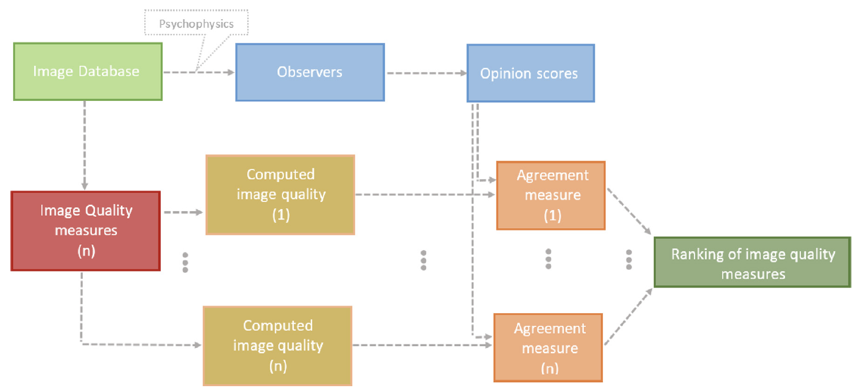
Flowchart

Slide 4
State of the art
Pearson correlation coefficient
Kendall correlation coefficient
Perceptually weighted rank correlation
Standardized residual sum of squares (STRESS)
Uncertainty Standardized residual sum of squares (USTRESS)

Slide 5
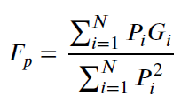
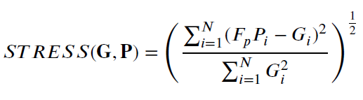
STRESS
Measure for multidimensional scaling

Slide 6
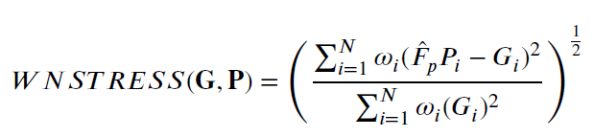
WSTRESS

Slide 7
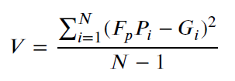


Statistical significance test for stress
The residual variance of the difference follows a Chi-squared distribution
The cotient between two Chi-squared variables follows a F distribution
Null hypothesis on the test and check its percentile in the distribution (p-value)

Slide 8
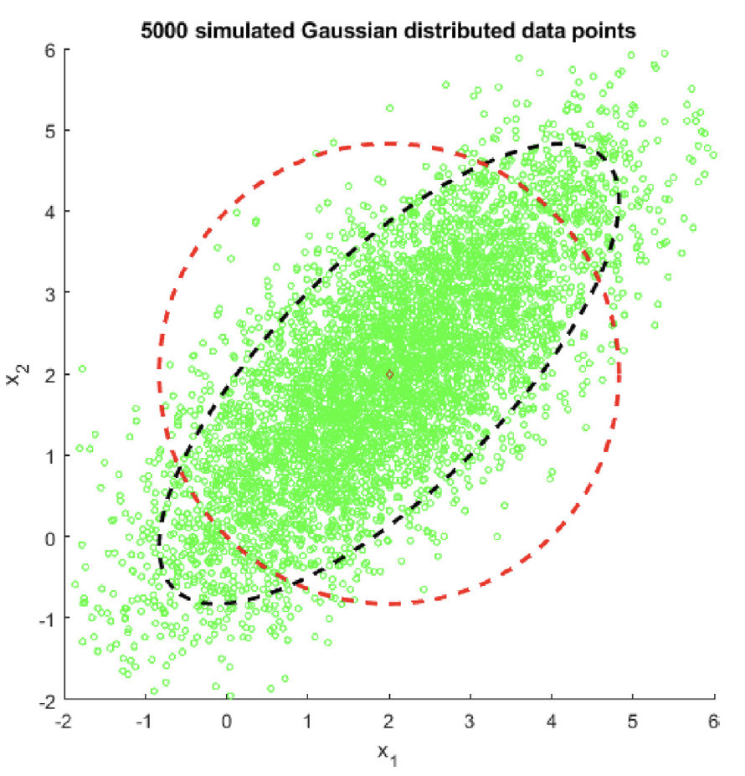

Ustress: adding uncertainty to stress
Motivated by Mahalanobis distance
If covariance matrix is replaced by identity matrix we have Euclidean distance

Slide 9
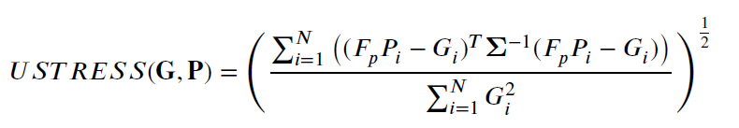
USTRESS
All depends on covariance matrix
Variability is only related to psychophysical data and not computed date
Predicted values are independent so covariance matrix should be diagonal
Variance of groundtruth data in the diagonal

Slide 10
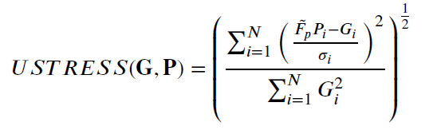
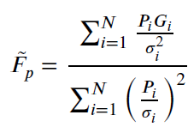
USTRESS

Slide 11
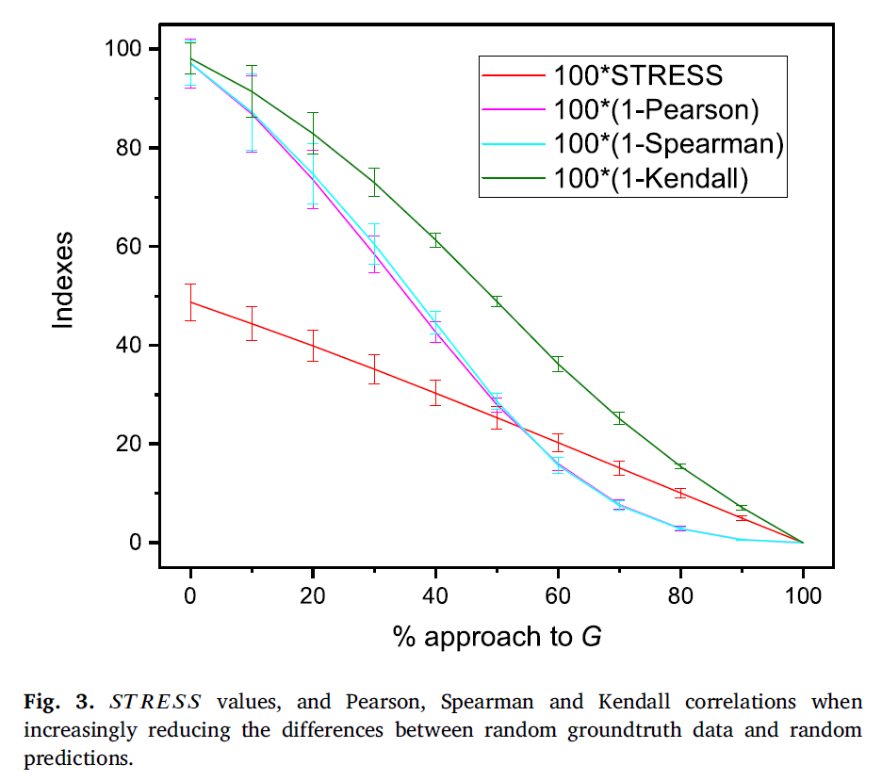
Experimental results: synthetic

Slide 12
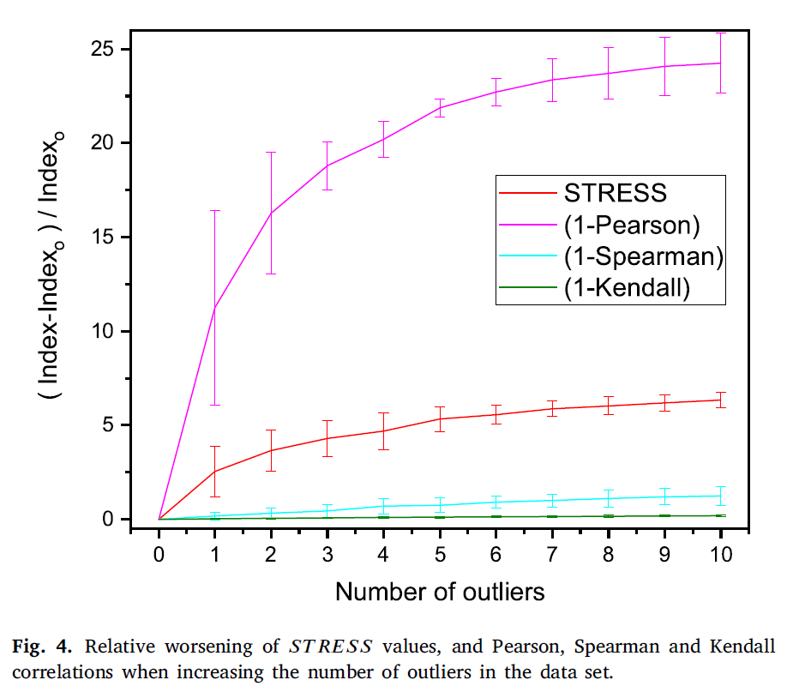
Experimental results: synthetic

Slide 13
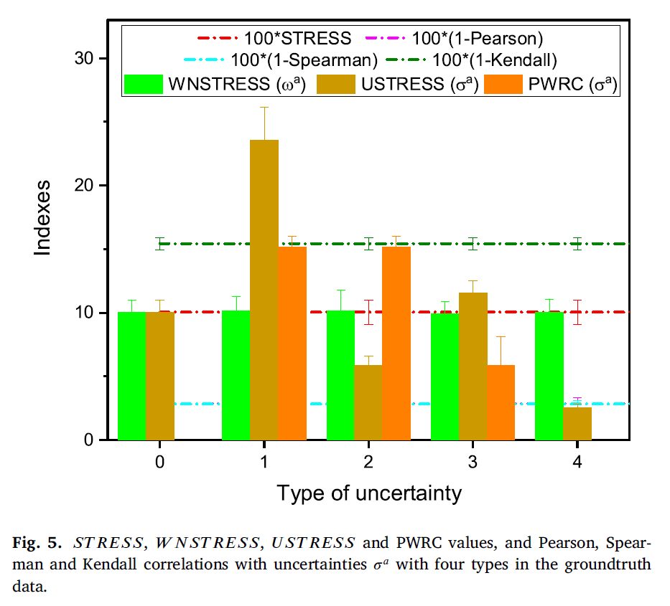
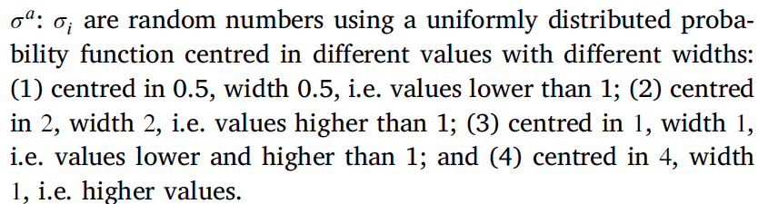
Experimental results: synthetic

Slide 14
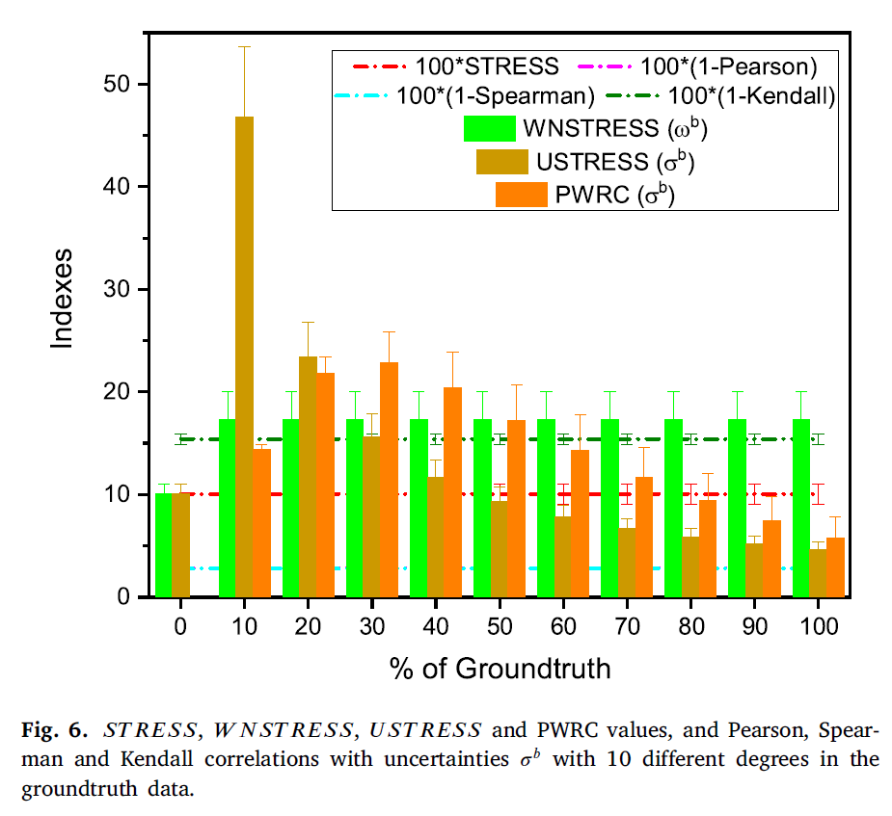

Experimental results: synthetic

Slide 15
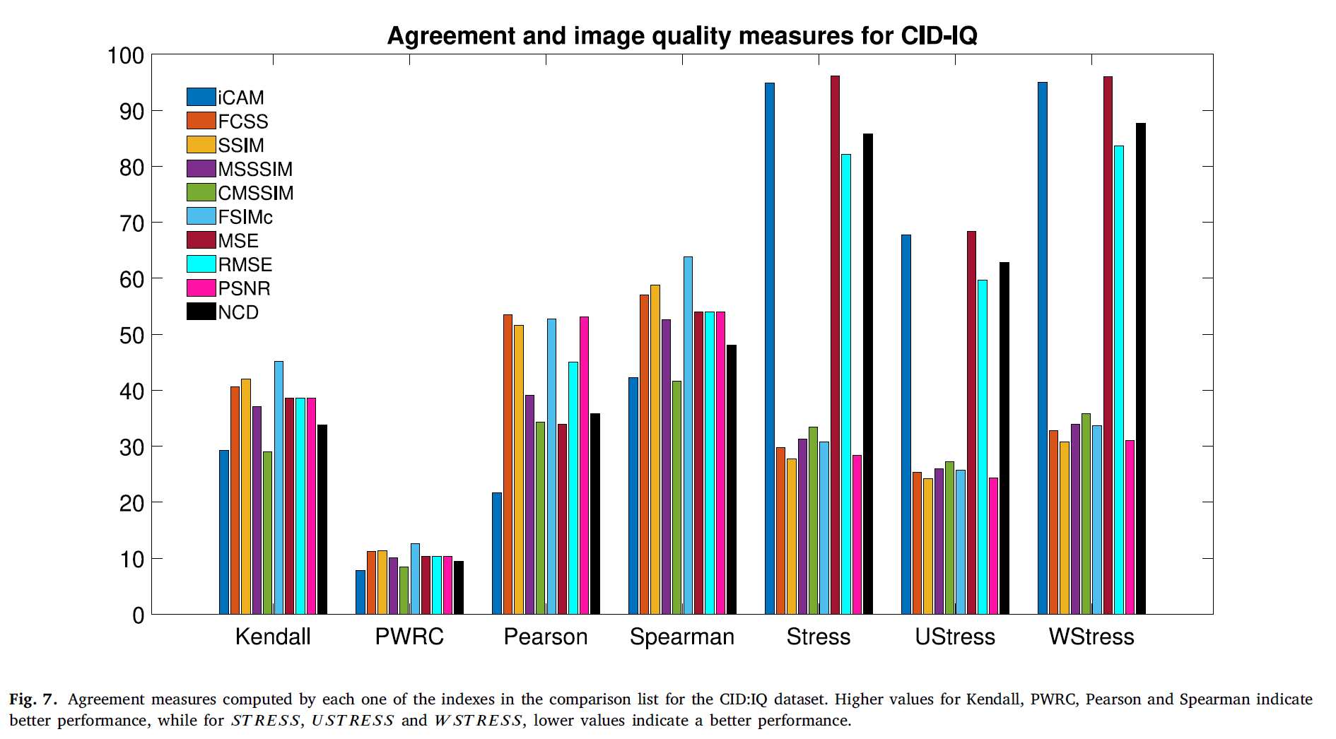
Experimental results: CID: IQ Dataset

Slide 16
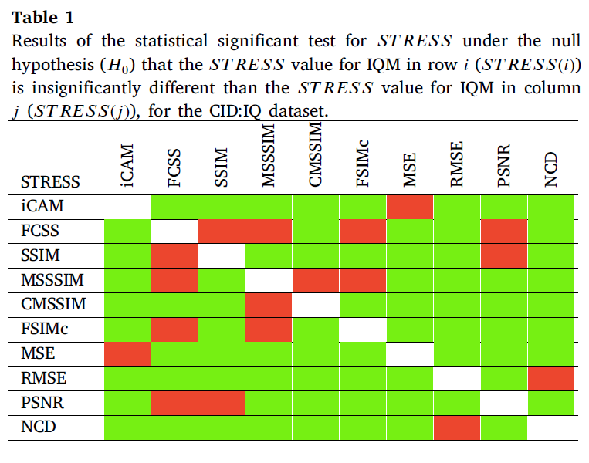
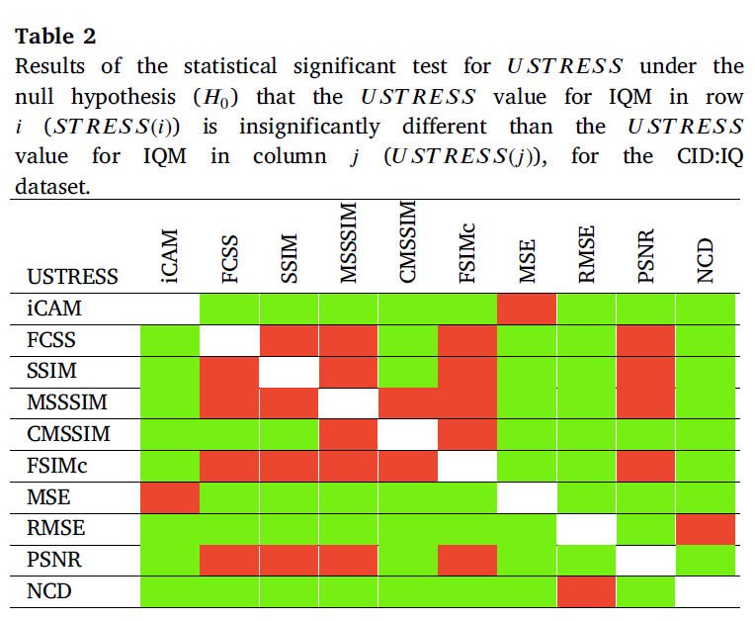
Experimental results: CID: IQ Dataset

Slide 17
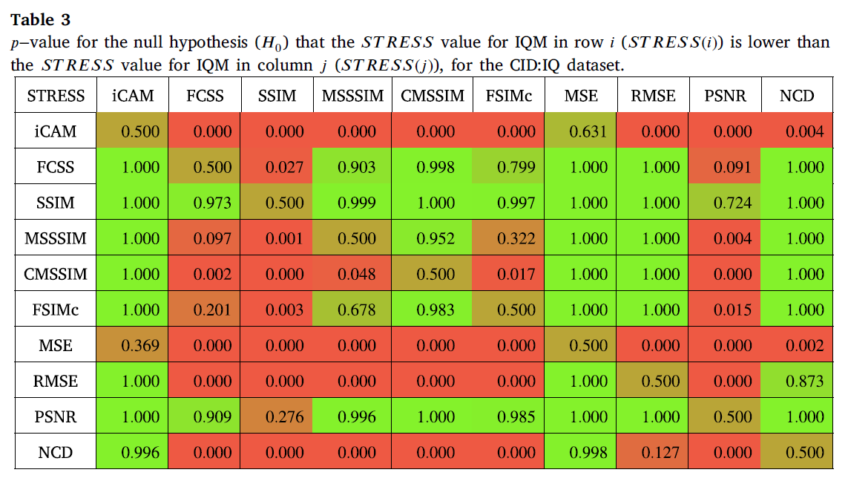
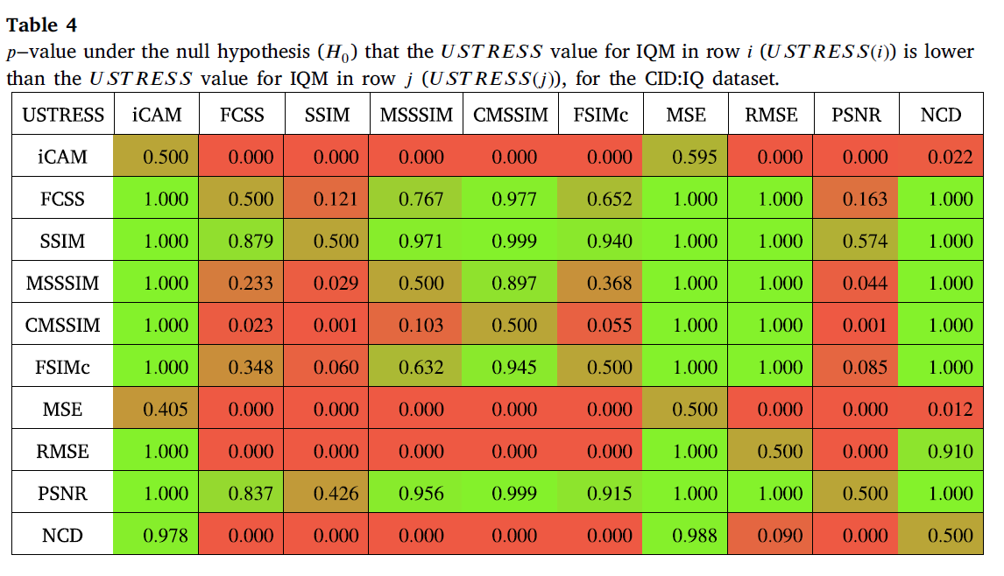
Experimental results: CID: IQ Dataset

Slide 18
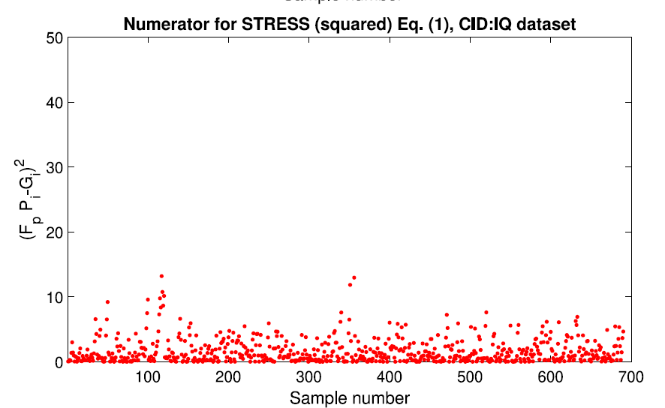
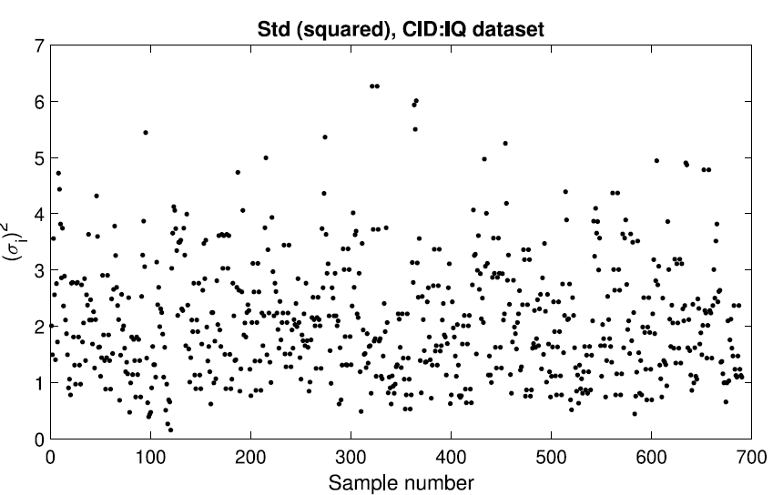
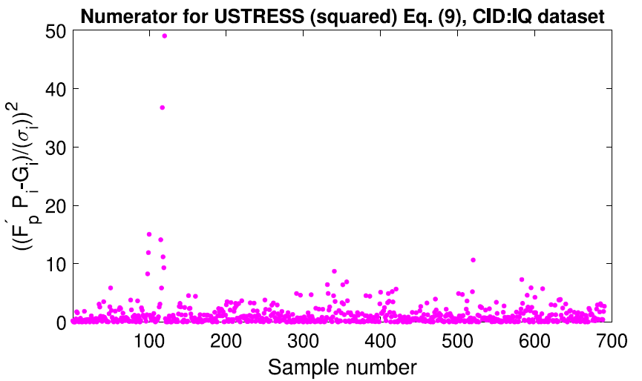
Experimental results: CID: IQ Dataset

Slide 19
Conclusions
Ustress is a mathemathical solid tool to measure agreement between psychophysical and computed scores
Accounts for subjective data variability
Allows to carry out statistical significance tests

Slide 20
Thank you
Samuel Morillas

